Slide 1
Sales Accreditation Summary Modules 1 & 2
Al-Futtaim Automotive Talent Centre
Date 12/09/2025

Slide 2
CHARACTERISTICS OF THE LEAD RESPONSE
FAST RESPONSE
(Timely)
Speed matters: Our response to leads MUST be timely.
Customers are looking for an almost instant response.
QUALITY RESPONSE
(Well planned)
A quality response will create trust and make it easier to build a relationship with customers.
CONVERT
(Appointment)
Having clear calls to action and next steps for the customer will help guide them through the sales process.

Slide 3

ATTRIBUTES OF QUALITY RESPONSE
Choose the right mode of response
Quick reply
Personalized & unique
Start a conversation

Slide 4
PICKING THE RIGHT MODE OF RESPONSE
If a phone number is provided:
Give the customer a call
Or use WhatsApp if notes as preferred method of communication
If a phone number is not provided:
Follow-up via email
Ask for phone number in follow-up response
Choose the right mode of response
Quick reply
Personalized & unique
Start a conversation

Slide 5
WHY IS IT IMPORTANT TO BE FAST?
Better Chances of Making a Sale
Happier Customers
Improve Brand Image
More Money in the Bank
Choose the right mode of response
Quick reply
Personalized & unique
Start a conversation
Notes:
Better Chances of Making a Sale: Quick replies mean you're more likely to turn a maybe into a yes.
Happier Customers: People love it when you answer fast. It shows you care and are ready to help.
Improve Brand Image: When you're quick to respond, people start thinking your brand is on the ball and reliable.
More Money in the Bank: The faster you respond, the more sales you're likely to make. And that means more profit.

Slide 6
PERSONALIZED & UNIQUE
Choose the right mode of response
Include customer’s name
Thank the customer for the inquiry
Introduce yourself & dealership
Provide your contact details
Use autoreply only after office hours
Quick reply
Personalized & unique
Start a conversation

Slide 7
START A CONVERSATION
Product questions – specifications, features and finance/insurance questions.
Price questions – these can range from vague price questions, to requests for detailed pricing and trade-in.
Dealership questions – including stock enquiries, opening hours and test drives.
Choose the right mode of response
Quick reply
Personalized & unique
Start a conversation

Slide 8
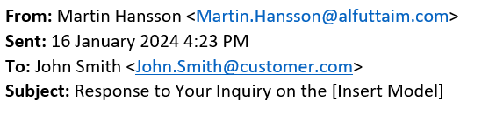
QUALITY RESPONSE - EMAIL
Email Subject Line:
A successful subject line has:
Clarity and Specificity
Urgency or Value Proposition
Personalization

Slide 9
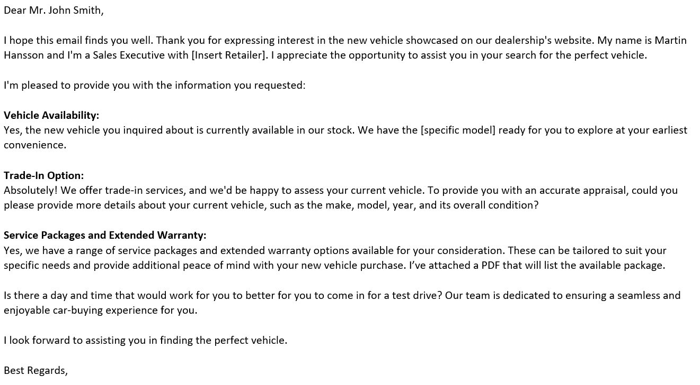
QUALITY RESPONSE - EMAIL
Greeting & Introduction:
Use a professional greeting addressing the customer by their name
Introducing yourself and where you’re from
Convene excitement and that you’re excited to work with the customer

Slide 10
QUALITY RESPONSE - EMAIL
Answer and Ask Questions:
Answer all questions the customer might have
Ask for clarification if needed to ensure there is no confusion
Opportunity to ask qualifying questions if appropriate

Slide 11
QUALITY RESPONSE - EMAIL
Call to Action:
Offer the customer clear next steps
Ask for an appointment or a follow-up call as you see fit
It is Important to highlight to the customer that you are flexible and here to support them

Slide 12
QUALITY EMAIL RESPONSE TEMPLATE
REVIEW
Appropriate descriptive subject line
Thanked them for their interest
Addressed prospective customers by name
Introduced yourself (Name, Position, Dealership)
Answered and/or addressed all questions
Spell and grammar check
Email can be read in 2 – 3 mins
Check

Slide 13

QUALITY RESPONSE BY PHONE
Greeting
Data verification
Confirm appointment
Build Rapport
Summary

Slide 14
QUALITY RESPONSE BY PHONE
Introduce yourself (Name, position, dealer name)
Ask the customer if this is a suitable time to have the call
Summarize the reason for the call and show appreciation for the customer interest in the brand/dealer
Greeting
Data verification
Confirm appointment
Build rapport
Summary

Slide 15
QUALITY RESPONSE BY PHONE
Name, Address, Email, Phone No.
If applicable - car of Interest (Model + MY)
Greeting
Data verification
Confirm appointment
Build rapport
Summary

Slide 16
QUALITY RESPONSE BY PHONE
Confirm that the pre-selected day and time for an appointment is correct.
If there’s a need to change the date/time – be flexible
Is it possible to do an at-home test drives
Greeting
Data verification
Confirm appointment
Build rapport
Summary

Slide 17
QUALITY RESPONSE BY PHONE
Answer and/or address any additional questions that might come up.
When possible, keep it brief.
Take note on any additional information the customer might mention.
Do they need help with directions to the showroom
Who else might be joining them for the appointment
Greeting
Data verification
Confirm appointment
Build rapport
Summary

Slide 18
QUALITY RESPONSE BY PHONE
Summarize all the agreements / booking / etc..
Thank the customer again for his time and interest
Follow-up with an email summary
Greeting
Data verification
Confirm appointment
Build rapport
Summary

Slide 19
QUALITY PHONE RESPONSE TEMPLATE
REVIEW
Preparation and review
Polite and professional tone
Active listening
Introduced yourself (Name, Position, Dealership)
Answered and/or addressed all questions
Take notes
Next Steps and clear follow-up plan
Check

Slide 20
QUALITY RESPONSE BY WHATSAPP
Timely Responses
Clear and Concise Information
Visual Content
Personalization
Privacy and Security

Slide 21
QUALITY RESPONSE BY WHATSAPP
Respond promptly to customer inquiries on WhatsApp.
Timely communication is crucial in the automotive sales process, as customers are often actively researching and considering their options.
Aim to provide information and assistance in a timely manner to keep the customer engaged.
Timely Responses
Clear and Concise Information
Visual Content
Personalization
Privacy and Security

Slide 22
QUALITY RESPONSE BY WHATSAPP
Avoid overwhelming the customer with unnecessary information
Ensure that the details provided are comprehensive enough to address their questions
Timely Responses
Clear and Concise Information
Visual Content
Personalization
Privacy and Security

Slide 23
QUALITY RESPONSE BY WHATSAPP
Leverage the multimedia capabilities of WhatsApp by sharing photos and videos of the vehicle or dealership
Visual content can significantly enhance the customer's understanding of the product
It can also create a more engaging and informative conversation
Ensure that the visuals are high quality and showcase the key features of the vehicle
Timely Responses
Clear and Concise Information
Visual Content
Personalization
Privacy and Security

Slide 24
QUALITY RESPONSE BY WHATSAPP
Similar to email, tailor your communication to the individual customer's needs and preferences
Ask qualifying questions if needed to better understand their specific wants and needs.
This personalized approach helps build a stronger connection and increases the likelihood of a successful sale
Timely Responses
Clear and Concise Information
Visual Content
Personalization
Privacy and Security

Slide 25
QUALITY RESPONSE BY WHATSAPP
Respect customer privacy and adhere to data protection regulations
Avoid sharing sensitive information unless necessary
If more confidential information or transactions are required, consider having those discussions in person or via a secure communication channel
Timely Responses
Clear and Concise Information
Visual Content
Personalization
Privacy and Security

Slide 26

QUALITY FOLLOW-UP
Remember
Identify the preferred communication channel
Communication becomes more effective, when we use customers preferred communication channel.
Doing so will enhance customer satisfaction, fostering long-term relationships and loyalty.

Slide 27


THE FIRST MEETING
Welcome the customer to the dealership in a professional and approachable manner
Ensure that the customer’s information is correct in C4C and updated if needed
Offer refreshments if available
Show them to either the showroom seating area, your desk, or products as appropriate
Give the customer your name and make sure you get theirs
Have notes prepared on what’s previously been discussed with the customer or any questions you might have
Offer help and advice as required
Build rapport with the customer

Slide 28
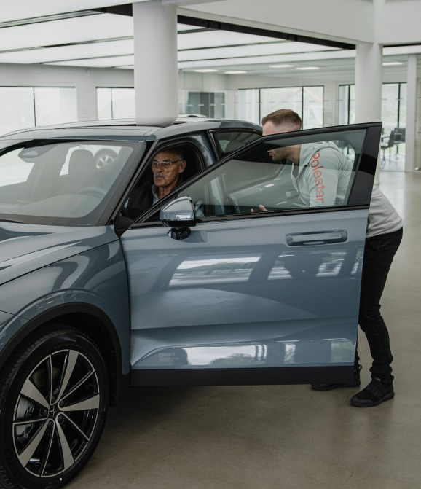
WHAT IS RAPPORT
Ensure your message is relevant and appealing
Establish common ground
Sound enthused and interested
Speak their language
Remain professional throughout
Be calm and relaxed
Ask Open Questions
Listen
Be conscious of body language
Mirror your customer’s body language
Appropriate eye contact
Smile!
Use their name

Slide 29
WHY IS GREETING CRITICAL IN THE FIRST MEETING?
First Impression Lasts
You are Selling yourself, your dealership, the experience and lastly the car
You want to get the customer comfortable
Building Trust & Rapport

Slide 30
GREETING MADE EASY
Professional Appearance
Personal hygiene
Outfit
Smile
Body Language
Introduction statement
Summarize the previous call
Manage Expectation

Slide 31
GREETING MADE EASY
Professional Appearance
Thank the customer for their interest in your product
Introduce yourself (Name and Job title)
Don’t forget your smile
Introduction statement
Summarize the previous call
Manage Expectation

Slide 32
GREETING MADE EASY
Professional Appearance
Summarize what you agreed on during your previous call (Model of Interest, Current Vehicle, etc.)
Introduction statement
Summarize the previous call
Manage Expectation

Slide 33
GREETING MADE EASY
Professional Appearance
Briefly describe to your customer what is going to happen (the process that you will take him/her through)
Introduction statement
Summarize the previous call
Manage Expectation

Slide 34
WHAT DEFINES EXCEPTIONAL EXPERIENCE
Personalized, tailored to that customer’s needs and interests
Attentive, listening, exploring preferences
Detailed with thoughtful touches
Consultative, relationship-based
Endures over time
Transparent, honest, credible

Slide 35

QUALITY NEEDS ASSESSMENT
What should be your main goal from the customer discovery process?
Collect as much information as possible
Customer MUST feel they are being listened to

Slide 36
QUALITY NEEDS ASSESSMENT
Confirm & Clarify Customer
Research
Determine where customer is at in the buying process through questions and conversation
Understand and clarify customer research
Conduct Needs Analysis
Confirm Vehicle Selection
Manage Expectation

Slide 37
QUALITY NEEDS ASSESSMENT
Confirm & Clarify Customer
Research
Utilize resources to assist customers in defining which vehicles, features or options they are interested in
Understand and clarify customer’s primary buyer motives
Conduct Needs Analysis
Confirm Vehicle Selection
Manage Expectation

Slide 38
QUALITY NEEDS ASSESSMENT
Confirm & Clarify Customer
Research
Review customer needs and wants
Provide vehicle recommendation based on information provided by the customer
Confirm vehicle availability and/or make alternate recommendations
Conduct Needs Analysis
Confirm Vehicle Selection
Manage Expectation

Slide 39









WHY DO PEOPLE BUY CARS?
SPECIT

Slide 40
CUSTOMER BUYING MOTIVES
S
Safety & Security
P
Performance
E
Economy, Environment, Electrification
SPECIT
C
Comfort & Convenience
I
Image
T
Technology

Slide 41

QUALITY NEEDS ASSESSMENT
Questions that could be asked
Influencers
How many kids?
The main Driver?
How many passengers?
Decision maker?
Needs
Budget
Competition

Slide 42
QUALITY NEEDS ASSESSMENT
Questions that could be asked
Influencers
Current Vehicle?
Type of usage?
Reasons to buy?
Travel patterns?
Cargo/Luggage?
Preferred colors?
Favorite sport?
Specific features?
Needs
Budget
Competition

Slide 43
QUALITY NEEDS ASSESSMENT
Questions that could be asked
Influencers
Budget?
Payment method?
Trade-in?
Timeline?
Needs
Budget
Competition

Slide 44
QUALITY NEEDS ASSESSMENT
Questions that could be asked
Influencers
Previous search?
Is it the 1st visit?
Any shortlisted vehicles (brands/models)?
Competition offers?
What you like in other brands?
Needs
Budget
Competition

Slide 45
Thank you!
See you next time!
Contact
Fatma Alsagaf Learning & Development Consultant
Al-Futtaim Automotive Talent Centre, Dubai, UAE
E-mail: Fatma.Alsagaf@alfuttaim.com

